Slide 1
Introduction to Software Engineering
Skills required to transform requirements into working software
Zeeshan Ali Rana

Slide 2
Software Engineering
Solving Problems
  Computers
  Computing
Multi-person construction of multi-version software

Slide 3
Software Engineering Challenges
… good enough software
Acceptable Quality
  Usability
  Security
  Reliability
  Performance
Cost Effectiveness
  Engineering and operational feasibility
  Limited development budget
Timely Completion
  Limited time
Conflicts?
Manage Conflicts…

Slide 4
Software Engineering
Disciplined, consistent, and systematic effort to construct (design + build) and maintain software in timely and cost-effective manner

Slide 5
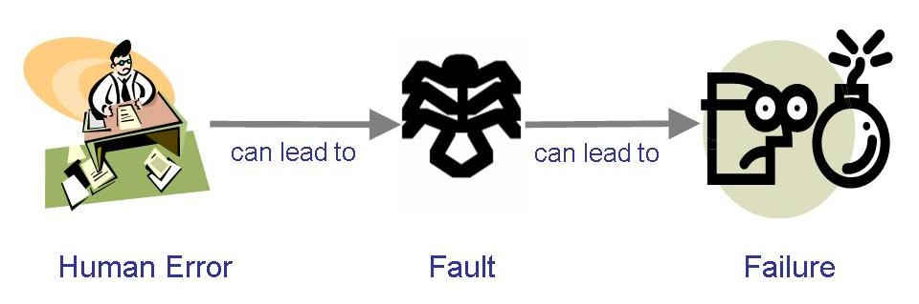
Terminology for Describing Bugs
A fault: occurs when a human makes a mistake, called an error, in performing some software activities
A failure: is a departure from the system’s required behaviour

Slide 6
Nature of Software

Slide 7
Software and Defects?
Software vs Engine (wear-out???)
Software vs House
Software vs Cars (models? Versions?)
Stability????
Problems??? Defects???
Malleable
Human intensive

Slide 8
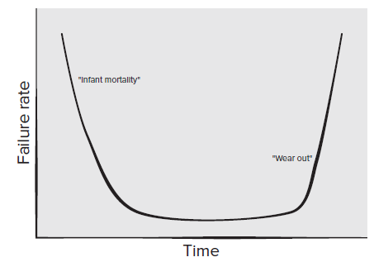
Failure Curve for H/W

Slide 9
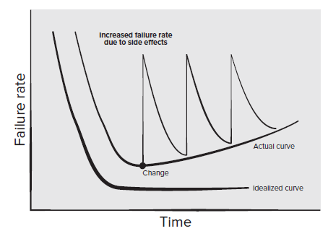
Failure Curve for S/W

Slide 10
Software Evolution

Slide 11
Lehman’s Laws
(1974) "Continuing Change" — A system must be continually adapted or it becomes progressively less satisfactory. It happens so until it becomes economical to replace it by a new or a restructured version
(1974) "Increasing Complexity/Entropy" —Complexity/entropy of a system increases with time, unless work is done to maintain or reduce it
(1991) "Continuing Growth" — the functional content of a system must be continually increased to maintain user satisfaction over its lifetime
(1996) "Declining Quality" — the quality of a system will appear to be declining unless it is rigorously maintained and adapted to operational environment changes

Slide 12
Example
Farmers and gardens, picking equal number of fruits…
 | Fruit 1 | Fruit 2 | Fruit 3
Farmer 1 | Garden 1 | Garden 2 | Garden 3
Farmer 2 | Garden 4 | Garden 5 | Garden 6
Farmer 3 | Garden 7 | Garden 8 | Garden 9
 | Fruit 1 | Fruit 2 | Fruit 3
Farmer 1 | 9 | 5 | 1
Farmer 2 | 6 | 7 | 2
Farmer 3 | 1 | 5 | 9

Slide 13
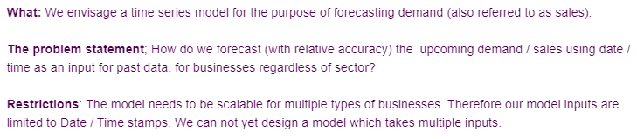
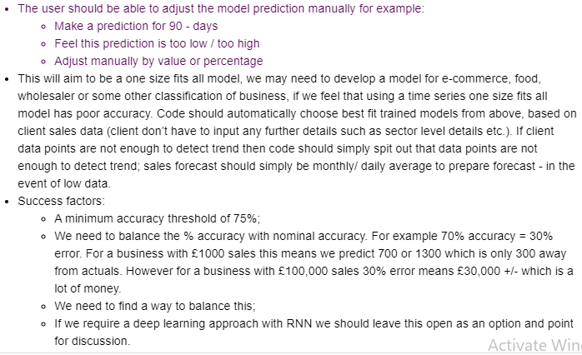
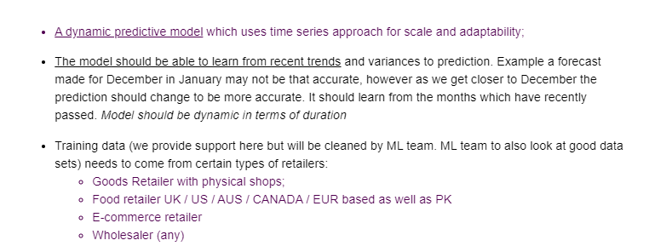
We need a time series model for the purpose of forecasting demand

Slide 14
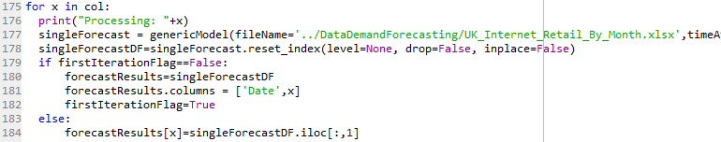
Examples
Write the forecast output in a file
Should be run once for multiple businesses

Slide 15
References
Roger Pressman, Software Engineering: A Practitioner’s Approach
Ghezzi et al., Fundamentals of Software Engineering
Pfleeger et al. Software Engineering, Theory and Practice

